Slide 1
DWI Blood Testing In New Jersey

Slide 2
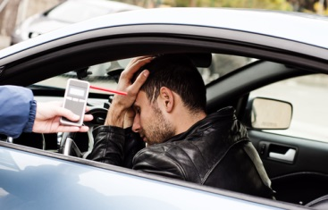
The police in New Jersey are legally allowed to stop a driver for suspicion of driving while intoxicated (DWI).
Once a driver is stopped for suspicion of DWI, a Breathalyzer test will be done to check the blood alcohol concentration (BAC) of the driver.

Slide 3
Sometimes the police officer may decide to take a sample of the driver’s blood for testing and analysis.
DWI blood testing is also done in cases where the driver has been seriously injured and is unable to take a Breathalyzer test.

Slide 4
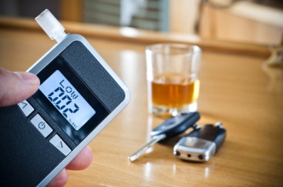
If the driver was stopped for suspicion of DWI and he or she refuses to take a Breathalyzer test, the police officer has the authority to take the suspect to the hospital to draw blood.
The arrested driver must agree to the blood test at the hospital.
Refusing to do so can result in serious penalties.

Slide 5
If you or someone you know has been charged with a DWI, it is important that you speak to a DWI defense lawyer immediately.
The consequences of a DWI conviction can be life-changing.
The Rubas Law Offices is experienced in handling DWI cases in New Jersey.
We can help you navigate the complicated workings of the legal system and the DMV.

Slide 6
Contact Us
Rubas Law Offices
549 Summit Avenue
Jersey City, NJ 07306
2006 Route 71, Ste. 6
Spring Lake Heights, NJ 07762
Spring Lake: 732-820-4332
Jersey City: 201-448-9866
Michael@Rubaslawoffices.com
www.rubaslawoffices.com

