Slide 1
Reasons to Hire a Criminal Defense Attorney

Slide 2
A criminal conviction can have serious consequences.
If you have been charged with a crime, it is important that you seek the help of a criminal defense attorney immediately.
A criminal defense lawyer by your side can help you lower your penalties and avoid other repercussions.
Here are some top reasons to hire a criminal defense attorney:

Slide 3
An attorney can examine the prosecution’s evidence
An experienced criminal defense lawyer can find the loopholes in the prosecution’s evidence and bring them to the court’s attention.

Slide 4
An attorney can help you in filing paperwork
An attorney can ensure that all of your paperwork is filled out correctly.
He or she would also ensure that all documents are filed according to the strict deadlines and procedures enforced by the court.

Slide 5
An attorney can seek to have your case dismissed
or the charges reduced
Your criminal defense attorney will work hard to have your case either dismissed entirely or the charges reduced.

Slide 6
An attorney can help you fight for reduced penalties
A criminal defense attorney is experienced and knows how to argue for the minimum consequences of a conviction.
He or she can fight for reduced penalties, such as little to no jail, through the use of probation or community service.

Slide 7
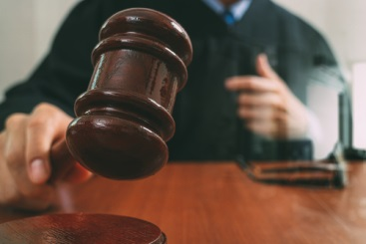
An attorney can protect you against fabricated testimonies
A criminal deferse attorney can help protect you against fabricated testimonies and assist you in uncovering the truth.

Slide 8
If you’ve been charged with a crime, don’t make the mistake of not hiring a criminal defense attorney.
At the Rubas Law Offices we are experienced in handling criminal charge cases. We can handle your case efficiently and effectively.

Slide 9
Contact us
Rubas Law Offices
732-820-4332 (Spring Lake)
201-448-9866 (Jersey City)
info@rubaslawoffices.com
www.rubaslawoffices.com

